Slide 1
Introduction to Data Science
A drink from the fire hose so you can start your own exploration.
Bryan Nehl
@k0emt
dbBear.com
Notes:
Slides will be posted.
dbBear.com has links to github, blog and twitter
Record thoughts and ideas not shown on the slides.
Big overview drink from the fire hose. Towels later.

Slide 2
What is Data Science?
Turns out, that’s a good question!
Skills
Sourcing
Extract, Transform and Load
Databases
Languages and Libraries
Business Knowledge
Visualization
What now?

Slide 3


Skills
Data Journal – Engineer’s Notebook
http://soloso.blogspot.com/2014/05/engineers-notebook.html
Regular Expressions, Markdown
Analysis (math/stats is part of this!)
LINUX/*NIX/OS X
putty
Version Control
http://git-scm.com/
Messaging – RabbitMQ
http://rabbitmq.com

Slide 4
Virtualization
Why?
Time
Pre-built images
Cost
On Demand
How/Where?
Microsoft Azure
Amazon Elastic Cloud
Google Compute
Heroku
Your Own Machine
Oracle VirtualBox -
www.virtualbox.org
Parallels
VMWare

Slide 5
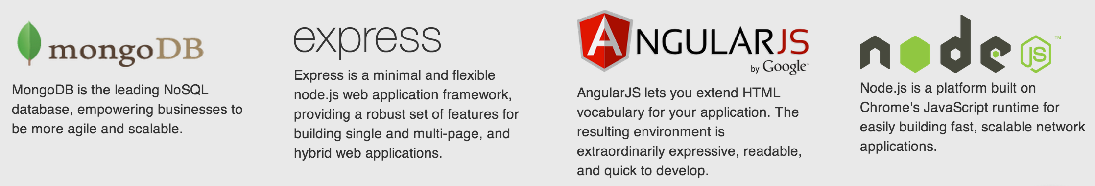
Common Virtual Machines (VMs)
LAMP/WAMP
Linux/Windows
Apache
MySQL
PHP
MEAN
MongoDB
Express
Angular
Node.JS
mean.io
Notes:
Screen capture from mean.io website

Slide 6
Data Sourcing

Slide 7
Sourcing the data
Locate it
Provided
Search for it
Manually
Automated
Networking
Get it
ftp
Scraping
Database
Web services
Work with it

Slide 8
Some dataz
data.gov
data.mo.gov
data.kcmo.gov
data.gov.uk
data.worldbank.org
gutenberg.org
http://bitly.com/bundles/hmason/1
soloso.blogspot.com/2011/07/getting-enron-mail-database-into.html

Slide 9
ETL
Extract, Transform and Load (the data!)

Slide 10
Extract, Transform & Load Data Formats
XLS
CSV
Text
Delimited
Fixed format
JSON – json.org
XML & HTML
Mail files
SQL scripted INSERTs
PDF
Character sets
https://docs.python.org/2/howto/unicode.html
Notes:
Extract – what you need
Transform – is shaping it
Load – typically into a database

Slide 11
Data Analysis
???
What do I expect to see?
What are the field types?
Does the field type change?
What are the range of values?
How frequently do those values occur?
Can I get a graph please?
Are there nulls?
How big is my sample set?
Is it significant?
How big do I expect the real data to be?
Are there holes in the data?
What constitutes a good record?
Where are the trends/clusters in the data?
Notes:
End with: These questions, among others, are what we have in mind as we look at tools and libraries to do the work.

Slide 12

openrefine.org
Explore
Clean and Refine
Matching
Exporting
Plug-in architecture
Works with web services
Works with freebase.com
Notes:
Formerly Google Refine

Slide 13
Languages and Libraries
Tools to get the work done. Don’t reinvent the wheel.

Slide 14


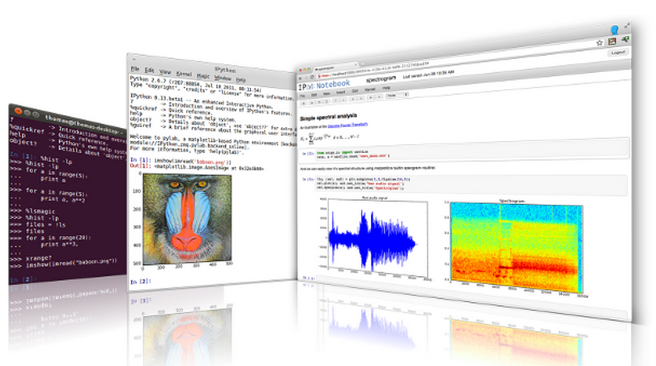
Languages
Python –python.org
IPython – ipython.org

Slide 15

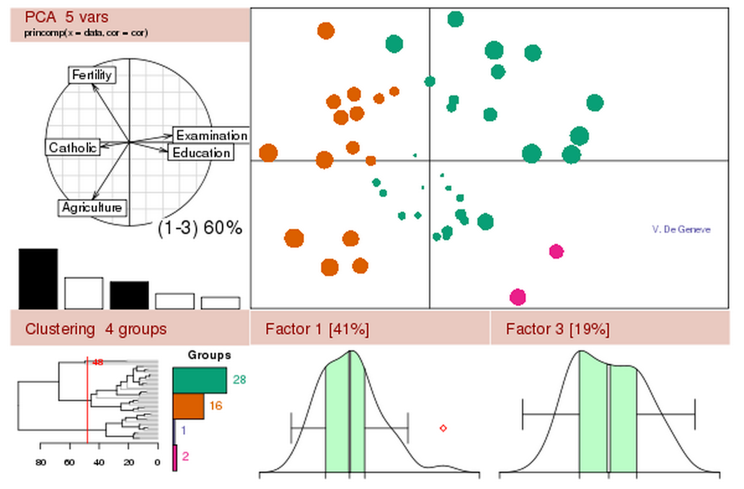

Languages
R - www.r-project.org
R Studio - www.rstudio.com

Slide 16

Languages
Julia – julialang.org
Very fast numeric operations
Close to FORTRAN in speed
Designed for parallelism
IJulia works with IPython
Javascript
jquery

Slide 17
Libraries for Excel
It is everywhere
Python Libraries:
xlrd
XlsxWriter
Apache Project – Office Open XML file formats
http://poi.apache.org/
Excel
Word
PowerPoint
Notes:
https://pypi.python.org/pypi/xlrd
https://pypi.python.org/pypi/XlsxWriter

Slide 18


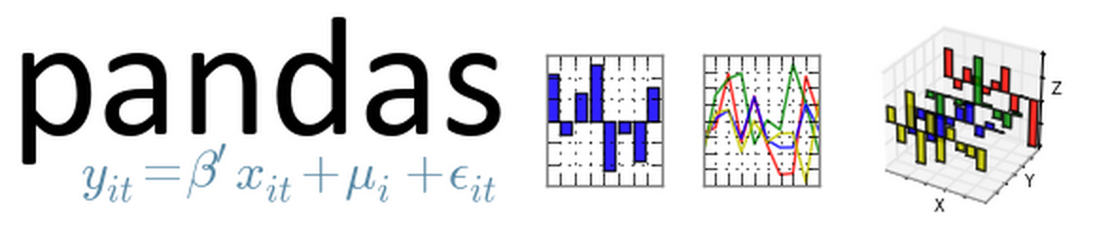
Libraries
SciPy
scipy.org
NumPy
numpy.org
Pandas - Python data analysis library
pandas.pydata.org
Notes:
SciPy is a core library for scientific computing that is part of the SciPy stack that includes NumPy and Pandas among others
NumPy – lots of math stuff
Pandas – analysis, great to pair with IPython

Slide 19

Libraries
lxml
lxml.de
pymongo
pypi.python.org/pypi/pymongo/
pika – AMQP
pypi.python.org/pypi/pika
nose – unit test framework extension
nose.readthedocs.org
Notes:
XmlSlurper for Groovy

Slide 20

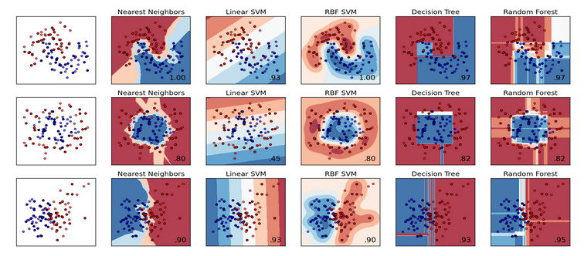
scikit-learn.org
Machine Learning
Clustering
Classification
Data Mining

Slide 21


Packages
Anaconda Scientific Python development environment
Getting IPython set up by hand is a pain—Anaconda is a must on Windows machines.
https://store.continuum.io/cshop/anaconda/
wakari.io web based Python data analysis

Slide 22


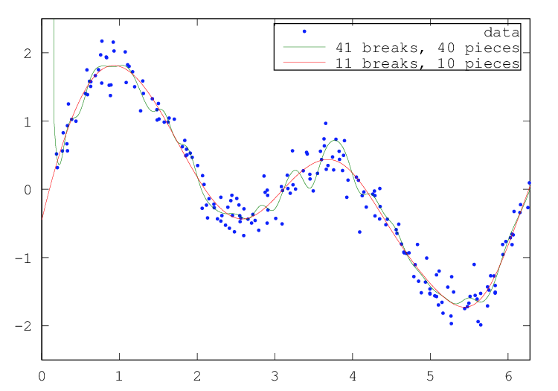
Other Tools
Processing.org
Octave
www.gnu.org/software/octave/
Notes:
Example of curve fitting with Octave

Slide 23
Databases
Choose the right one(s) for the job!
Polyglot Persistence
http://martinfowler.com/bliki/PolyglotPersistence.html

Slide 24




Relational - SQL
MySQL
open source
Oracle
Microsoft SQL Server
Express Editions
Microsoft Access
ODBC / JDBC
Notes:
There are express editions of both Microsoft SQL server and Oracle Database

Slide 25



NOSQL
Definition
MongoDB – JSON/BSON documents
mongodb.org
neo4j – graph
neo4j.org
PostgreSQL – object-relational
postgresql.org
Notes:
What does it mean to be document oriented?
neo4j – relationships, route finding, impact analysis
PostgreSQL is also ACID and supports most SQL 2008 types

Slide 26



NOSQL
Aerospike – Key-Value
aerospike.com
redis – Key-Value
redis.io
CouchDB – JSON docs, HTTP
couchdb.apache.org
Couchbase – JSON, memcached
couchbase.com
Notes:
http://www.aerospike.com/ - synchronous replication, ACID, Linux only, designed for SSDs
redis.io – async replication, locks, multiplatform
http://couchdb.apache.org/
Couchbase also has cross data center replication!

Slide 27


Distributed framework for processing large datasets
MongoDB and other databases can be used to feed it
MapReduce
hadoop.apache.org
In Memory MapReduce
spark.apache.org
Notes:
http://hadoop.apache.org/

Slide 28
Example Polyglot System Lobbyist Influence
Relationships:
Politicians
Lobbyists
Legislation
PDF Versions of the bill
Financial information

Slide 29
Business Knowlege
I have data. Now what?

Slide 30
Numbers need context
Visitors
1M
Page Views
5.2M
72%
Conversion Rate
42
Customer average age
1
Top Referrer.com
Notes:
Numbers without context are meaningless

Slide 31
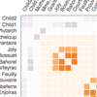

Analysis
Techniques
Adjacency Matrix
pivot and fold operations on tables
hexagonal binning
confusion matrix
predictive modeling fundamentals
machine learning
The work of John Tukey (Statistics)
wikipedia.org/wiki/John_Tukey
Notes:
Keep Google busy!
http://en.wikipedia.org/wiki/Pivot_table
http://en.wikipedia.org/wiki/Fold_(higher-order_function) also known as aggregate
hexagonal binning, which uses hexagon shapes to create a grid and develop a spatial histogram.
https://www.mapbox.com/blog/binning-alternative-point-maps/

Slide 32
What can I do with this data that will benefit the business?
Is there some insight I can bring?
Can I generalize from this data? (global)
Can I ascertain local area insights?
Are there natural partitions in the data?
Gender, race, age, location?
Is there some business pain I can relieve?
Can I enhance an existing data set?
Can I bring in the data product with a shorter cycle time?

Slide 33



Business Intelligence
wikipedia.org/wiki/Business_intelligence
Pentaho - pentaho.com
Tableau - tableausoftware.com
Microsoft Power BI for Office 365
microsoft.com/en-us/powerbi/
Notes:
From wikipedia: Business intelligence (BI) is a set of theories, methodologies, architectures, and technologies that transform raw data into meaningful and useful information for business purposes. BI can handle enormous amounts of unstructured data to help identify, develop and otherwise create new opportunities. BI, in simple words, makes interpreting voluminous data friendly. Making use of new opportunities and implementing an effective strategy can provide a competitive market advantage and long-term stability.[1]

Slide 34
Visualization
Use your pixels!

Slide 35
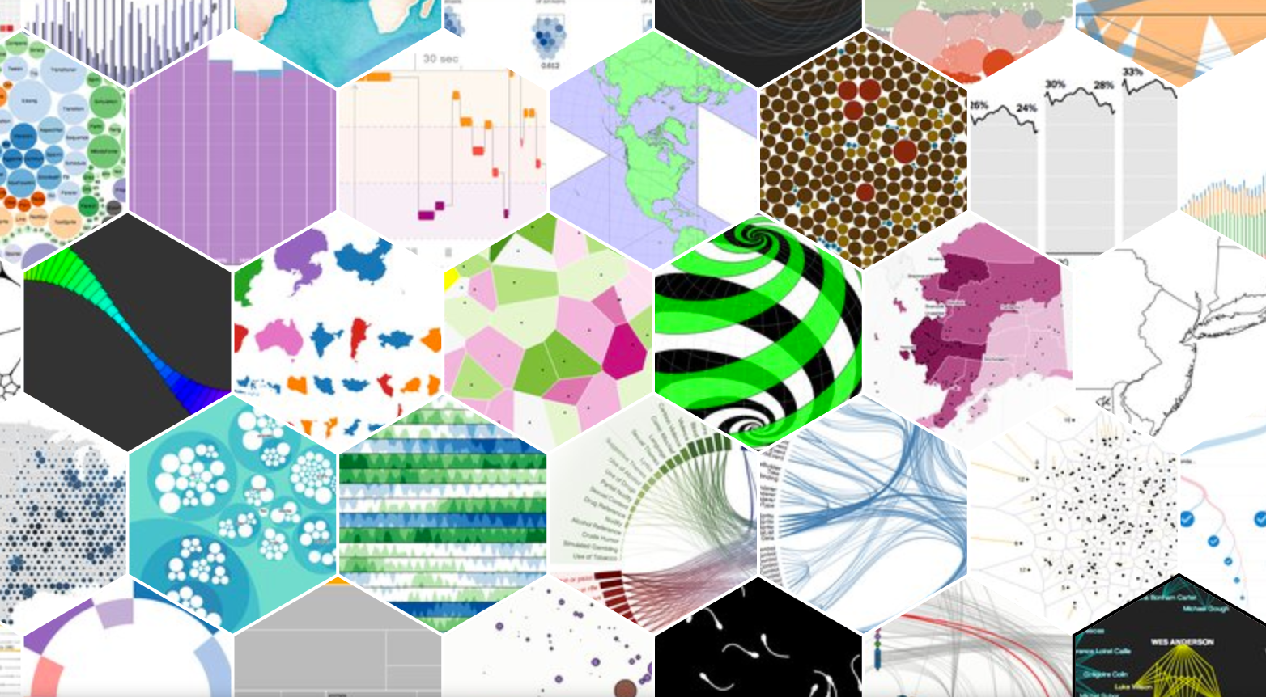
HTML Tools & Libraries
HTML5 / CSS3
Javascript
d3.js – d3js.org
HTML 5 canvas charts
chartjs.org
canvasjs.com
Notes:
d3.js is visualization software!

Slide 36
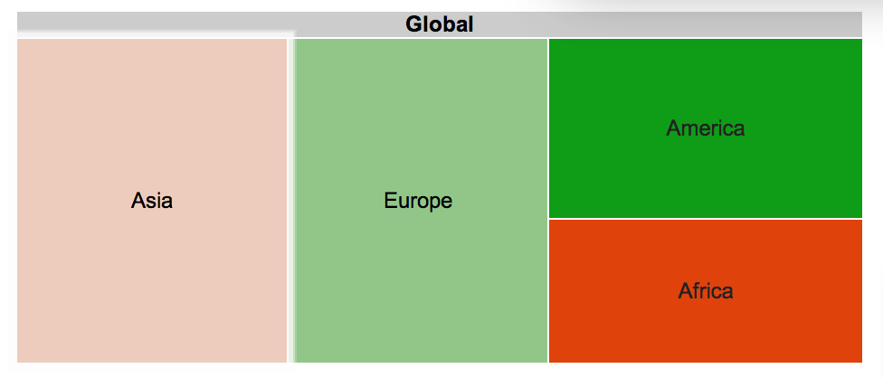
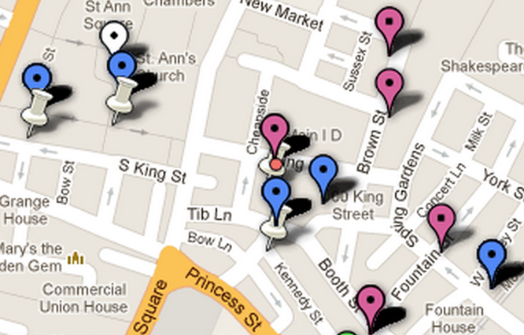
Google Tools & Libraries
Google Charts
developers.google.com/chart/
Google Fusion Tables
Now integrated with Google Drive

Slide 37

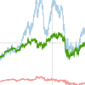
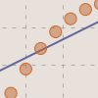
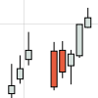
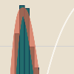
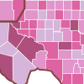
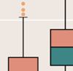
Python Tools & Libraries
bokeh - bokeh.pydata.org

Slide 38
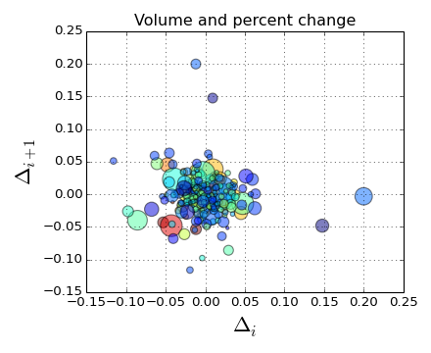

Python Tools & Libraries
Matplotlib
matplotlib.org
Mayavi 2
code.enthought.com/projects/mayavi/
Notes:
Mayavi – can do interactive 3D visualization

Slide 39
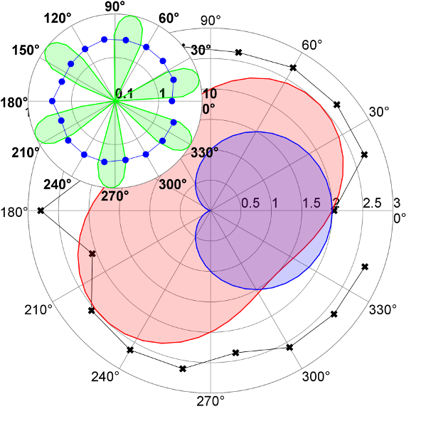
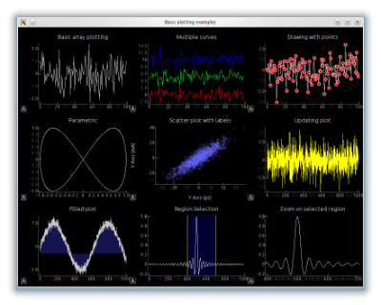
Python Tools & Libraries
home.gna.org/veusz/
pyqtgraph.org
Notes:
Polar visualizations
Integrated controls

Slide 40
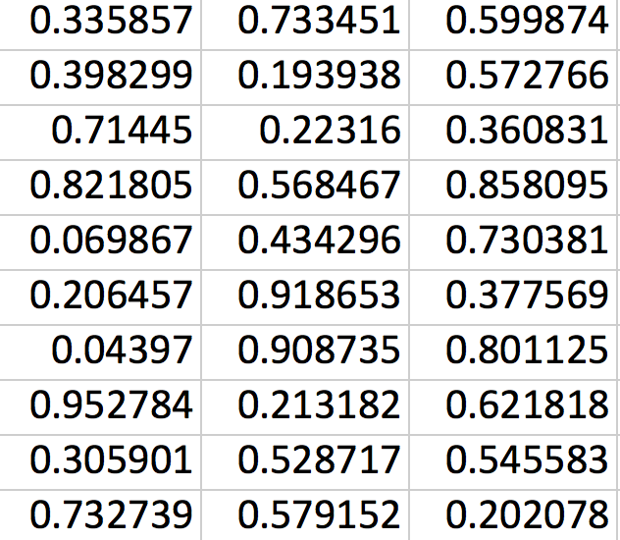
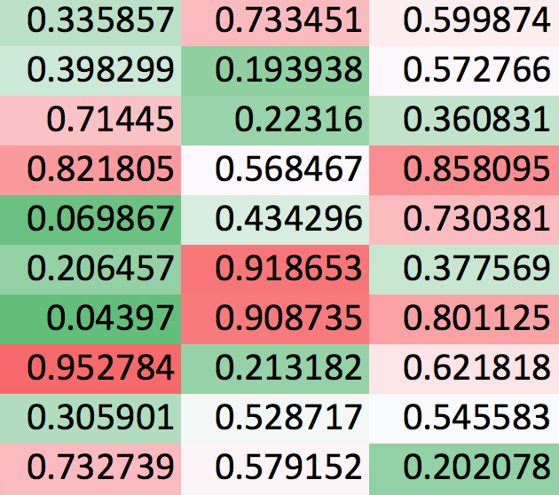
Excel: data quality check
Notes:
Don’t forget about the tool you likely already have

Slide 41
Map Projections
http://en.wikipedia.org/wiki/List_of_map_projections
http://xkcd.com/977/
http://www.jasondavies.com/maps/countries-by-area/

Slide 42
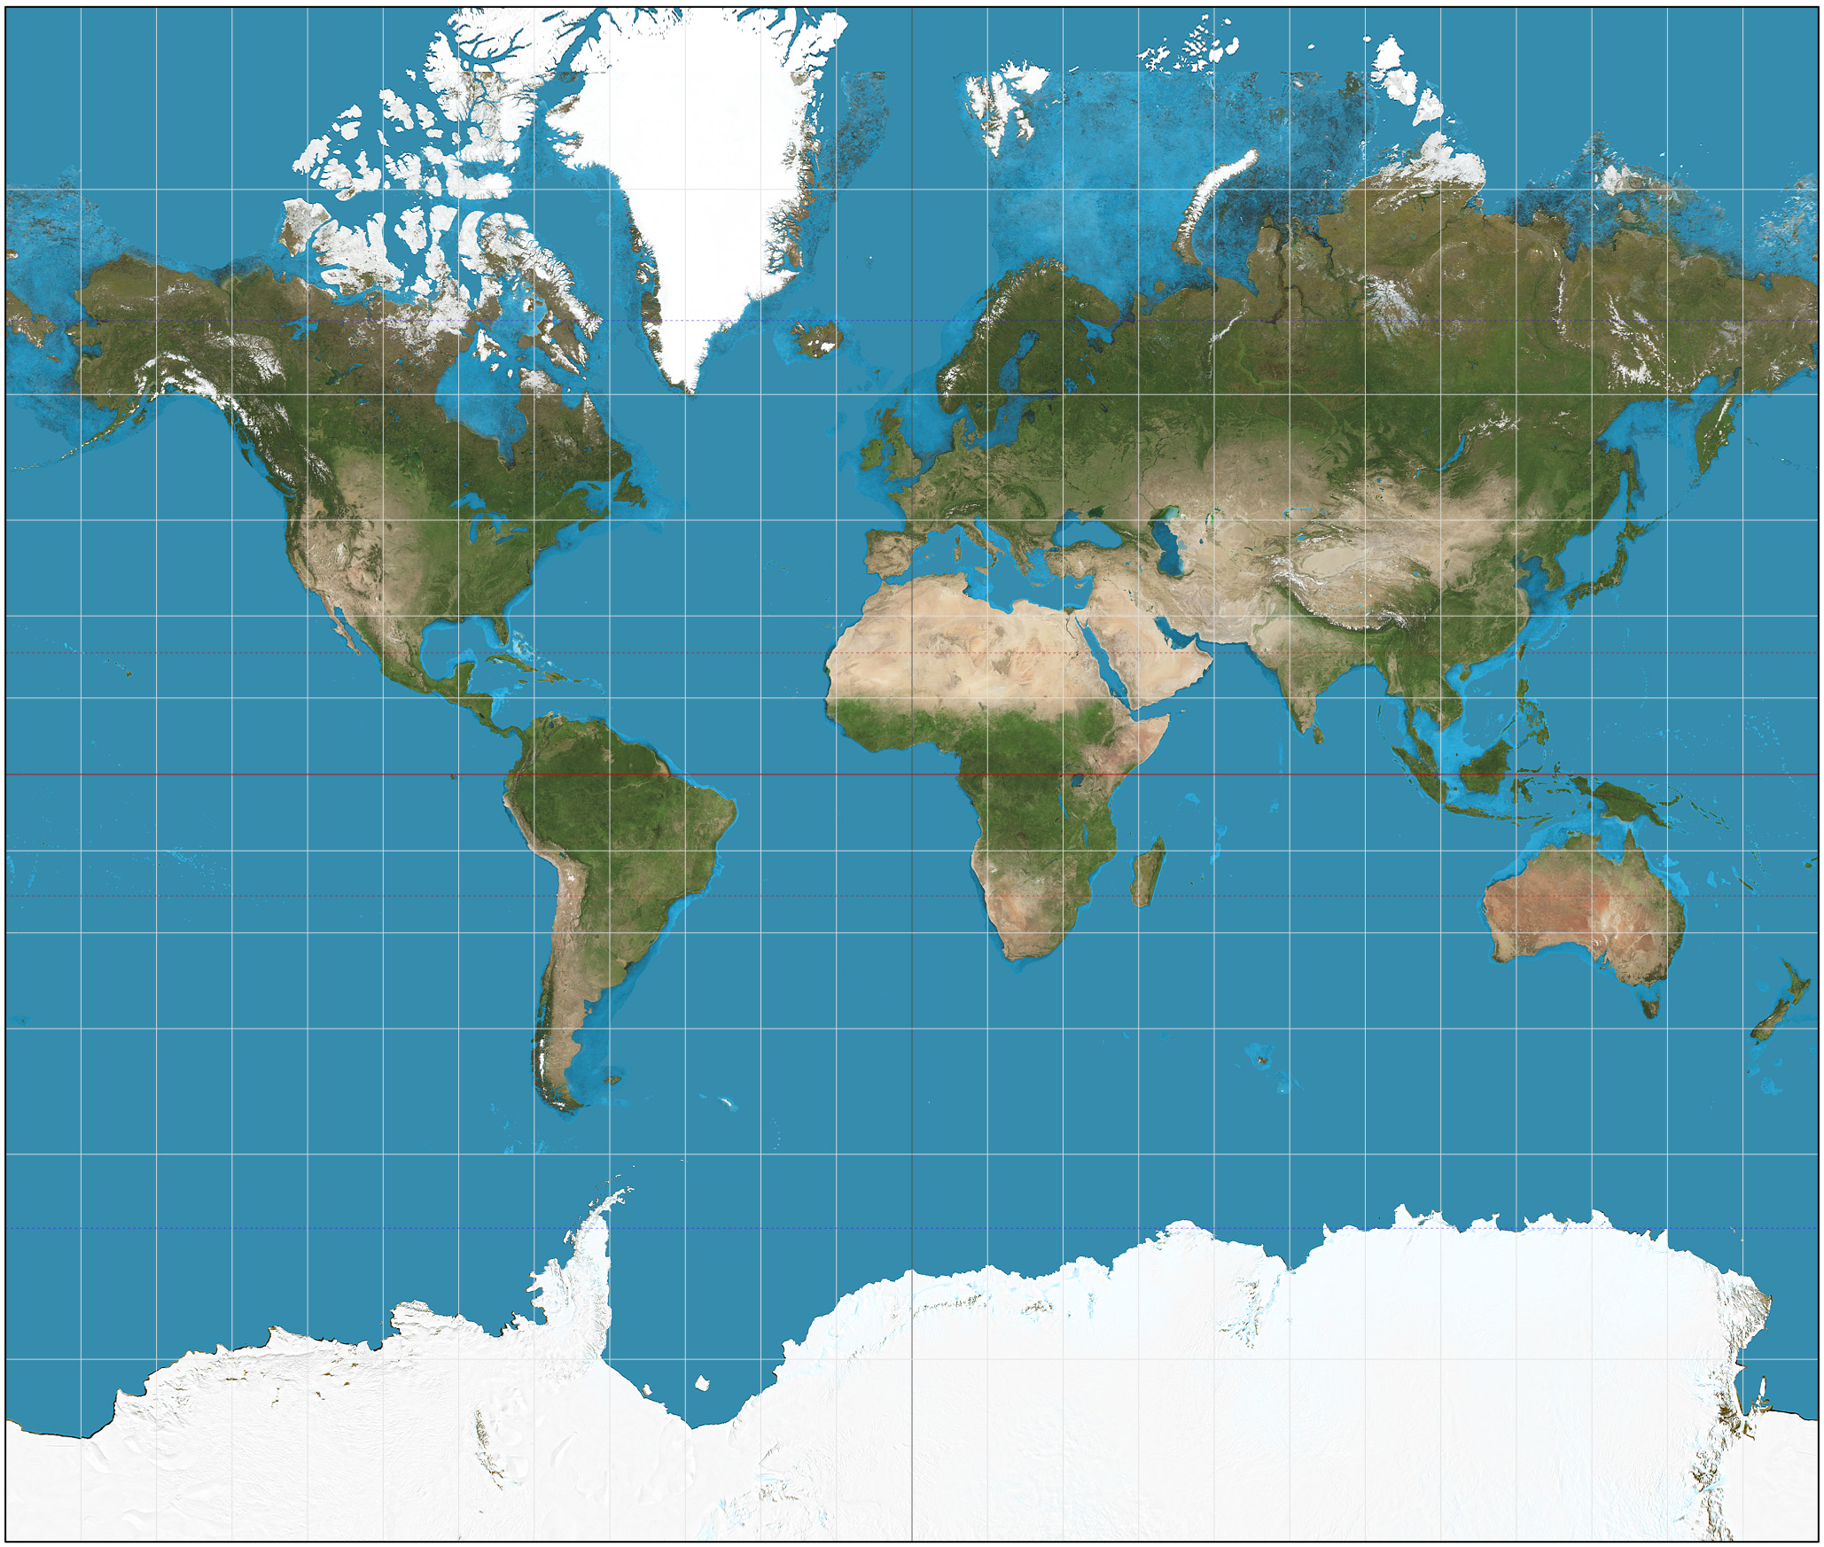
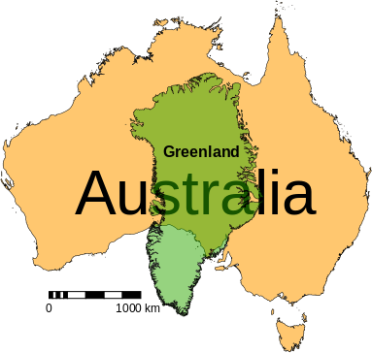
Mercator
http://upload.wikimedia.org/wikipedia/commons/f/f4/Mercator_projection_SW.jpg
http://commons.wikimedia.org/wiki/File:Australia-Greenland_size_comparison.svg
Notes:
Note the sizes Greenland and Australia

Slide 43

Goode homolosine projection
Equal area projection map
http://en.wikipedia.org/wiki/File:Goode_homolosine_projection_SW.jpg

Slide 44

What now?
That was a
BIG drink
from the fire hose!

Slide 45
Teams

Slide 46
Decide your direction
Personal Tech Radar
http://nealford.com/memeagora/2013/05/28/build_your_own_technology_radar.html

Slide 47
Training
Tutorials and sample files that come with software.
Local courses
Online Education from vendors
MongoDB University
university.mongodb.com
Other online education
Coursera – coursera.org
iTunes University (iTunes U)
O’Reilly Safari, books, videos and free publications
oreilly.com/data/free

Slide 48
Experiment
Set up a development environment
Create a Virtual Machine
Try out stuff
Work related
Something you are passionate about
Share your experiences
blog, tweet, present
GitHub and Gists

Slide 49
Contests
kaggle.com
www.kdnuggets.com/competitions/
www.crowdanalytix.com
www.innocentive.com
tunedit.org
Tips for winning
http://www.allanalytics.com/author.asp?doc_id=268513

Slide 50
Mentors & Community
Google+
Data Science
Statistics and R
Artificial Intelligence
Machine Learning
Python
MongoDB
LinkedIN
Twitter
IRC
People within your company
Notes:
Twitter - #hashtag search

Slide 51
Conferences
Strata
strataconf.com
PyData
pydata.org
PyCon
us.pycon.org
Big Data Summit KC
BigDataSummitKC.org
Investigative Reporters & Editors Conference
www.ire.org/conferences/

Slide 52
Introduction to Data Science Questions?
Bryan Nehl
@k0emt
dbBear.com
(Links to Twitter, blog, GitHub, gists)

